Slide 1
Serial Peripheral Interface - SPI
Dr.Sreejith Rajan

Slide 2
SPI
SPI (Serial Peripheral Interface) is a synchronous serial communication protocol used to connect a microcontroller (Master) with one or more peripheral devices (Slaves) such as sensors, displays, and memory chips.
It was developed by Motorola and is widely used in embedded systems because it is fast, simple, and full-duplex (data can be sent and received at the same time).

Slide 3
SPI – Common Usage
Common peripherals that use SPI:
OLED and TFT displays
Temperature and pressure sensors (BMP280, MAX6675, etc.)
Memory chips (EEPROM, Flash)
ADC and DAC Ics
SD cards

Slide 4
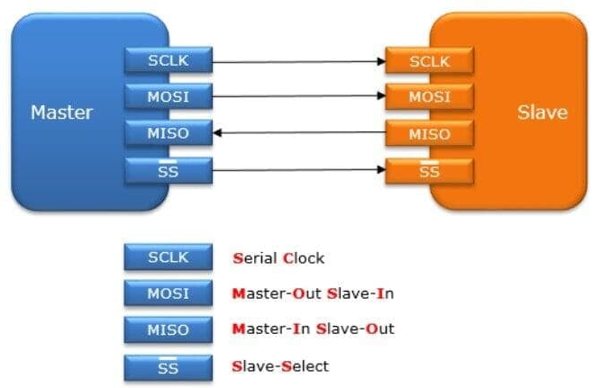
SPI Protocol
1
Line | Direction | Description
MOSI | Master → Slave | Master Out, Slave In (data from master to slave)
MISO | Slave → Master | Master In, Slave Out (data from slave to master)
SCK | Master → Slave | Serial Clock (generated by master)
SS (CS) | Master → Slave | Slave Select (active LOW, selects the slave)

Slide 5
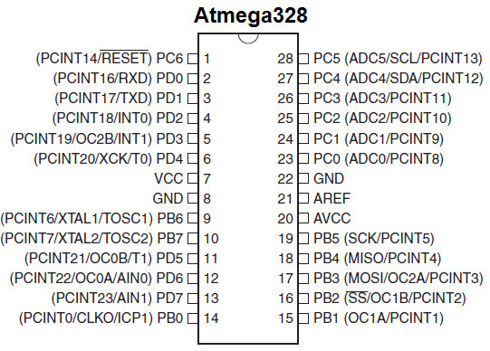
ATMEGA 328 Pin mapping
SPI Line | AVR Pin | Arduino Pin
MOSI | PB3 | D11
MISO | PB4 | D12
SCK | PB5 | D13
SS | PB2 | D10

Slide 6
Useful Registers
Register Name | Address | Purpose
SPCR | 0x2C | SPI Control Register — used to configure SPI mode and enable it
SPSR | 0x2D | SPI Status Register — shows SPI transfer status and flags
SPDR | 0x2E | SPI Data Register — holds data to transmit or receive
1

Slide 7
SPCR – SPI Control Register
Bit | Name | Description
7 | SPIE | SPI Interrupt Enable (1 = enable interrupt on transfer complete)
6 | SPE | SPI Enable (1 = enables SPI peripheral)
5 | DORD | Data Order (0 = MSB first, 1 = LSB first)
4 | MSTR | Master/Slave Select (1 = Master mode)
3 | CPOL | Clock Polarity (0 = SCK idle low, 1 = SCK idle high)
2 | CPHA | Clock Phase (0 = sample on leading edge, 1 = sample on trailing edge)
1 | SPR1 | SPI Clock Rate Select bit 1
0 | SPR0 | SPI Clock Rate Select bit 0
1

Slide 8
SPI Clock rate Table
SPR1 | SPR0 | SPI2X (in SPSR) | SCK Frequency
0 | 0 | 0 | fosc / 4
0 | 0 | 1 | fosc / 2
0 | 1 | 0 | fosc / 16
0 | 1 | 1 | fosc / 8
1 | 0 | 0 | fosc / 64
1 | 0 | 1 | fosc / 32
1 | 1 | 0 | fosc / 128
1 | 1 | 1 | fosc / 64
1

Slide 9
SPSR – SPI Status Register
Bit | Name | Description
7 | SPIF | SPI Interrupt Flag (set when transfer complete)
6 | WCOL | Write Collision Flag (set if SPDR written before previous transfer ended)
5–1 | — | Reserved
0 | SPI2X | Double SPI Speed Bit (1 = double speed)
1

Slide 10
Steps to configure SPI in ATMega 328 (Master) – Step1: Understand the pins
Signal | AVR Pin | Arduino Pin | Direction (Master) | Function
MOSI | PB3 | D11 | Output | Master Out Slave In
MISO | PB4 | D12 | Input | Master In Slave Out
SCK | PB5 | D13 | Output | Serial Clock
SS | PB2 | D10 | Output | Slave Select (active low)

Slide 11
Step 2: Set the Pin directions
In master mode
MOSI, SCK, and SS must be outputs.
MISO must be input.

Slide 12
Step3 : Enable SPI and configure as master
Bit | Field | Meaning
SPE | SPI Enable | Must be set to 1 to enable SPI
MSTR | Master Select | 1 for Master mode
SPR1, SPR0 | Clock Rate Select | Choose SPI clock speed
CPOL, CPHA | Clock Polarity & Phase | Define SPI mode (0–3)

Slide 13
Step4 : (Optional) Double the SPI Clock Speed
If you want to increase the SPI clock, set the SPI2X bit in the SPSR register.

Slide 14
Step 5 : Transmit and Receive Data
Use the SPDR register (SPI Data Register).
➔Writing to SPDR starts transmission.
➔Reading SPDR gives received data.
➔Wait for the transfer to complete by checking SPIF flag in SPSR.

Slide 15
Step 6 : Handle the SS (Slave Select) Pin
Before sending data to a specific device:
➔ Pull SS low → select slave.
➔ Transfer data.
➔ Pull SS high → deselect slave

Slide 16
Data Transfer in SPI

Slide 17
How SPIF is cleared ?
SPIF becomes 1 when the data transfer is complete
SPIF is automatically cleared when we read SPDR( or copy the SPDR Value to a variable)
That means we do not need to clear SPIF manually. It will be done when we read the SPDR value(That means we must read SPDR)

Slide 18
BMP 280
The BMP280 is a digital barometric pressure and temperature sensor made by Bosch Sensortec. It’s widely used in embedded systems and IoT applications like:
Altimeters
Weather monitoring
Environmental sensing
Smart watches and wearables
It can communicate via I²C or SPI, making it easy to interface with microcontrollers like the ATmega328

Slide 19
Electrical Parameters
Parameter | Typical Value | Notes
Operating Voltage | 1.71V – 3.6V | Often powered from 3.3V
Interface | I²C or SPI | Selectable by CSB pin
Pressure Range | 300 hPa – 1100 hPa | Equivalent to 9,000 m to -500 m altitude
Temperature Range | -40°C to +85°C | Suitable for most embedded systems
Resolution | 0.16 Pa (pressure), 0.01°C (temp) | Very precise
Supply Current | ~2.7 µA (normal mode) | Very low power

Slide 20
BMP 280 Pinout
Pin | Full Name | Description | Connect To (ATmega328)
SCL | Serial Clock | SPI clock line | PB5 (SCK)
SDA | Serial Data | MOSI (Master-Out Slave-In) | PB3 (MOSI)
SDO | Serial Data Out | MISO (Master-In Slave-Out) | PB4 (MISO)
CSB | Chip Select Bar | Active-low select pin | PB2 (SS) or any digital output you control as CS
VCC | Power | 3.3 V supply | 3.3 V
GND | Ground | Common ground | GND

Slide 21
Reading and Writing –BMP 280
Operation | Meaning
Write | The microcontroller sends data to the BMP280 to set something — like a configuration, control command, or reset.
Read | The microcontroller asks the BMP280 to send back data — like sensor readings or status information.
➔ These operations are done through registers inside the BMP280.
➔Each register in the BMP280 is like a small “memory box” with an address and a stored value.

Slide 22
Reading and Writing –BMP 280
Bit | 7 | 6–0
Meaning | R/W bit | Register address (7 bits)
Bit 7 ➔ 0 Means Write operation
Bit 7 ➔1 Means Read operation

Slide 23
Role of Registers in BMP 280
Register | Address | Purpose
Chip ID | 0xD0 | Read-only, fixed value 0x58
Reset | 0xE0 | Write-only, write 0xB6 to reset
Status | 0xF3 | Shows if measurement is running
Ctrl_Meas | 0xF4 | Controls oversampling and power mode
Config | 0xF5 | Filter and standby settings
Data registers | 0xF7–0xFC | Raw pressure and temperature data

Slide 24
Read the Chip id of BMP 280
PORTB &= ~(1 << PB2);
SPDR=OxD0|0x80;
while(!(SPSR & (1 << SPIF)));
Dummy = SPDR;
PORTB |= (1 << PB2);
PORTB &= ~(1 << PB2);
SPDR=Ox00;
while(!(SPSR & (1 << SPIF)));
Chip_id = SPDR;
PORTB |= (1 << PB2);
If(chip_id==0x58) {
Led on code }
Else {
Led off code
}

Slide 25
Display ChipID in Serial Monitor(UART)
Ideally, you can write UART send program(We already did)
Or use my UART driver codes (In my GitHub)

Slide 26
Read Temperature Value from BMP 280
Temperature and Pressure data are 20-bit data saved in 3 registers
Address | Register Name | Function
0xFA | TEMP_MSB | Temperature bits [19:12]
0xFB | TEMP_LSB | Temperature bits [11:4]
0xFC | TEMP_XLSB | Temperature bits [3:0] (upper nibble)

Slide 27
Read Temperature Value from BMP 280
➔Read individually and store in separate variables.
➔Combine to get the Raw Temperature value

Slide 28
What if your BMP 280 is in sleep mode
Enable CTRL_MEAS by writing 0x27 to it.

Slide 29
Get Temperature Compensation values
➔Temperature compensation values are stored in the following registers
➔Read Them and use them to find the actual temperature value from raw
temperature value
Constant | Address (LSB) | Address (MSB) | Data type | Bits | Example value
dig_T1 | 0x88 | 0x89 | uint16_t | 16 | 27504
dig_T2 | 0x8A | 0x8B | int16_t | 16 | 26435
dig_T3 | 0x8C | 0x8D | int16_t | 16 | -1000

Slide 30
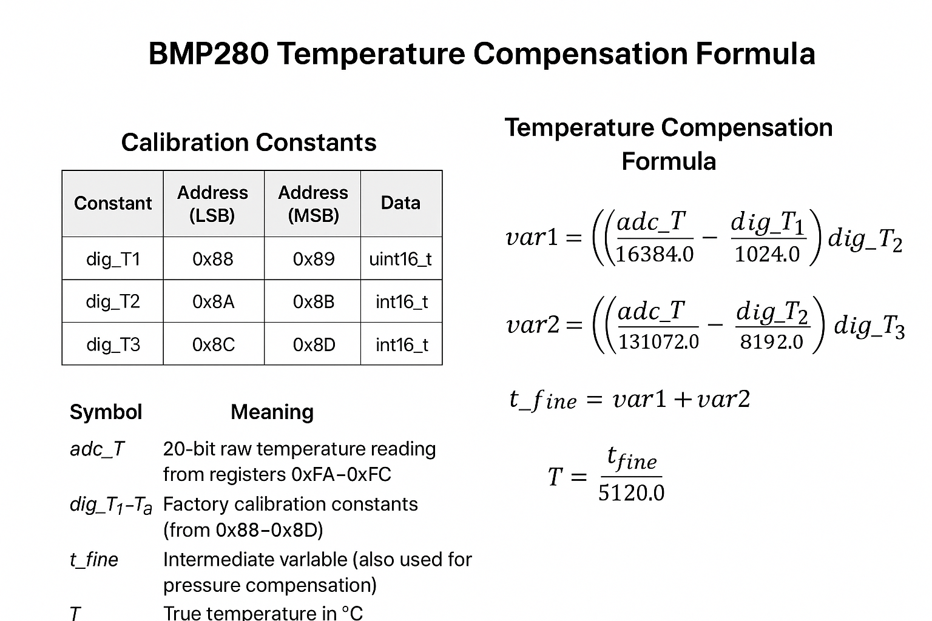
Temperature compensation Formula
3

Slide 31
THANK YOU

